Slide 1
Management of Fibroids
SIG Endocrinology 2019
Chairperson – Madhuri Patil

Slide 2
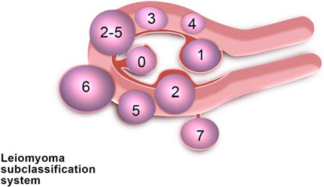
Fibroids
Benign monoclonal tumours arising from the myometrium of the uterus & made of extracellular matrix with collagen, fibronectin & proteoglycans
Classified: FIGO has classified according to Munro et al 2011.
Type 0- pedunculated, intracavitary
Type 1- Submucosal (<50% intramural)
Type 2- Submucosal (≥50% intramural)
Type 3 - Abutts endometrium (100% intramural)
Type 4 - Intramural
Type 5 - Subserosal (≥ 50% intramural)
Type 6 – Subserosal (<50% intramural)
Type 7 – Subserosal , pedunculated
Type 8 – Others (Cervical / parasitic)
Incidence & prevalence
- Prevalence increases from puberty to menopause. Women in reproductive age have higher incidence 40-60% by age 35 yrs & 70-80% by 49 yrs.
- Prevalence is high in African-American women compared to Caucasians & occurs at an earlier age. Women with early onset of puberty & obesity are at increased risk .

Slide 3

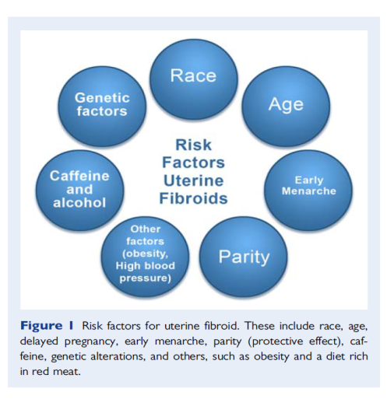
Risk factors For Fibroids
Jacques Donnez,2017

Slide 4
Pathophysiology of Fibroids
Disordered myofibroblasts in extracellular matrix
Cells proliferate dependent on E2 and P4
E2 induces PR & the effect of P4 on the fibroid, proliferation & survival
Estrogen is by itself insufficient for fibroid growth in the absence of P4 & PR

Slide 5
Presenting complaints
Gynecological
Obstetrical / Infertility
Symptoms depend on size, location & number of fibroids
- Heavy menstrual bleeding leading to anemia / reduced quality of life (HMB)
- Mass abdomen, pelvic or abdominal discomfort
- Symptoms of pressure like constipation / urinary frequency or difficulty in urinating & hydronephrosis
- Dyspareunia
- Severe pain abdomen due to degeneration / torsion
- Leiomyosarcoma –rare
- Infertility
- Miscarriage I &II trimester
- LSCS rates increased
- Preterm delivery / malpresentation labour difficulties / PPH
- Acute pain due to red. Degeneration (5-6%)
Examination:
P/A- mass arising from pelvis, smooth to multinodular, firm to soft (if degenerating) / hard with side-side mobility present.
P/V- mass arising from pelvis & into abdomen & moves with cervix

Slide 6
Mechanism Of Infertility
Interference with sperm or ovum transport
Enlargement and deformity of the uterine cavity
Uterine contractility
Distortion of the cervix
Distortion or obstruction of the tubal Ostia
Implantation failure or gestation discontinuation
Alteration of the endometrial contour
Persistence of intrauterine blood or clots
Focal endometrial vascular disturbance
Endometrial inflammation
Secretion of vasoactive substances
Enhanced endometrial androgen environment
Interfere normal rhythmic uterine contractions
Abnormal endometrial maturation
Alteration on oxytocinase activity
Myometrial / endometrial gene expression

Slide 7
Fibroids & Pregnancy
Increased risk of spontaneous abortion, premature labor (15% to 20% ), intrauterine growth restriction (10% ), malpresentation (20%)
Fibroids located adjacent to the placental site were associated with an increased risk of bleeding, abruption, and premature rupture of membranes
1.4% to 8.6% of pregnancies
Associated with fibroid

Slide 8
  Principles: Good counseling of risks/ benefits / skill of surgeon / availability of techniques at the centre / patient age & desire for fertility
Management
Differential Diagnosis
Investigation
- Adenomyosis (esp. when multiple intramural fibroids giving a smooth contour)
- Pregnancy
- Benign ovarian mass / Hgic. Cyst / dermoid cyst / endometrioma
- Malignant mass, ovarian Ca./ Endometrial Ca. / Leiomyosarcoma
- USG (TAS / TVS) – Gold Standard
- Saline sonography especially for diagnosis of sub-mucous fibroid
- 3D USG gives accuracy in location
- MRI - exact locations / size / vascularization / relation with serosa & cavity. In future high resolution MRI may help in sarcoma detection, hence is superior to all other diagnostic method
- Hysteroscopy – for intra-cavitary fibroids also for fibroids associated with DUB / hyperplasia
Treatment
Asymptomatic fibroids
Symptomatic fibroids
- No need to monitor the size
- Hysterectomy should not be advised
- Referred for secondary care only if :
* Palpable abdominally
* Seen intra-cavitatary
* UCL > 12cm

Slide 9
Symptomatic Fibroids
Medical
Surgical
Only short term relief
NSAIDS
- Reduces dysmenorrhoe (not supported by studies)
Oral Contraceptives
- Reduces HMB
- Size to be monitored
- Studies limited
LNG – Intrauterine Device
- Reduces HMB - Increased expulsion rates - Studies limited
Hormonal therapy
Hysterectomy
Myomectomy

Slide 10
Hormonal Therapy
Anti-progesterone Agents
Aromatase Inhibitors
GnRH Agonists / antagonists
Mifepristone acts on progesterone receptors in the fibroids & decrease volume by 26-74%
- Recurrence rate is less
- Amenorrhoea is 90%
- Bone marrow density is not affected
Side Effects:
- Endometrial hyperplasia without atypia
- Transient rise in transaminase levels
- Larger studies awaited
- Decreases E2 levels by peripheral block
- 35-65% decrease in volume in 3 months
- Size/ symptoms decreases
- Side effects less
- Studies limited
- Pre-operative correction of anaemia & to reduce intraoperative blood loss, though studies have not proven.
- Long term use results in side effects
- Hence if required add back therapy with Tibolone / raloxifene / estriol / Ipriflavone → to improve bone density
Tibolone & MPA reduces vasomotor symptoms

Slide 11
Hormonal Therapy
Danazol
Chemically similar to 17α-ethinyl testosterone
Estrogen Receptor Antagonist (Fulvestrant)
Down regulation /degradation of E2 receptors.
Not very effective in decreasing uterine volume/ nor HMB
SERM’S: nonsteroidal drugs binding to ER & either act as agonist / antagonist
Tamoxifen has agonis action on uterus hence not used
Raloxifene is widely studied and its combination with GnRH agonists causes shrinkage of fibroids effectively.
SPRM’S:
Fibroids over express ER & PR
Mefipristone – pure antagonistic -11 RCTs in 2013 revealed significant fibroid volume and decrease in symptoms
Ulipristal acetate (UPA) has mixed agonist / antagonist properties. Insufficient evidence of atypical endometrial hyperplasia as a S/E
Competes with androgens / progesterone / glucocorticoids at different levels of HPO uterine axis
Inhibits ovarian steroidogenesis
20-25% fibroid volume reduction happens
Long term response in terms of reducing HMB is good.
No RCTs available
SPRM’s have agonists / antagonist / mixed effects on progesterone target tissues

Slide 13
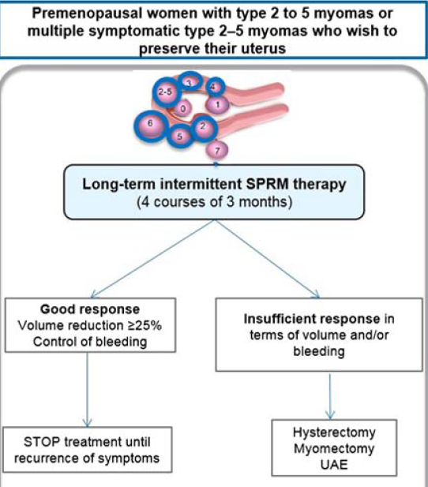

Slide 14
Myomectomy
Hysteroscopy
Laparoscopy
Laparotomy
Adv:
- Reduced blood loss
- quick recovery
- Less hospital stay
- Reduced post op. pain
- Less complications
Disadv:
- Multiple fibroid / 5-8 cm size / deep intramural – longer operating time & blood loss.
- Conversion to abdominal is 11%
- Recurrence rate -12% end of 1 year
- Safe
- Relieves symptoms
Risks:
- Hysterectomy
- Blood loss
- Risk of transfusion
- Adhesions
- Recurrence
: 27% risk of single fibroid ,
59% risk of multiple
fibroid.
- Preop GnRH agonists use is controversial
- Removal in one sitting is 85-95%
- 2nd hysteroscopy – 5 to 15%
- Recurrence rate 5% at end of 1 year
- Complications: Fluid overload, pulmonary edema, intra/ postop bleeding, uterine perforation, infection, gas. Embolism
- Risk is averted by bipolar / laser energy instead of monopolar cautery
- PR following surgery is 45% (2014 Donnez)

Slide 15
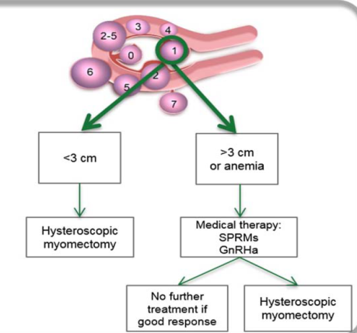
Submucous Myomas

Slide 16
Adjuvants
Pre-operative
Intraoperative
GnRH agonists:
  Time to correct anaemia
  Reduction in ut. size could help in change of surgical procedure
  Decreased blood loss.
  Recurrence risk is high
  Fibroids soften & planes of dissection becomes distinct
GnRH antagonists
  Decreases volume of fibroid by 25-40% in 19 days, easing surgery
  Rapid action without initial flare effect, thus lessening side effects
To minimize blood loss various adjuvants like misoprostol / vasopressin / Bupivacaine plus epinephrine / tranexamic acid / Tourniquet
No RCTs available

Slide 17
Minimally Invasive Procedures / Myolysis
UAE
Laparoscopic Nd-Yag-Laser
MRI – Guided focused USG energy
- Coagulates myoma & devascularises shrinking fibroid.
S/E: 10-50% dense adhesions
- Risk of uterine rupture is high
- Not recommended in patients desiring pregnancy
- High intensity USG waves
- Results in protein denaturation
- Coagulative necrosis
- 71% symptoms decrease in 6 mths & 51% at 12 mths
Side Effects:
- persistent pain / bleeding
- HMB
- Self limiting sciatic nerve sonification resulting in leg/ buttock pain
Laser Photo Coagulation
Different energy sources & techniques results in fibroid necrosis
Lack good quality evidence on effectiveness & safety
Fibroid volume decreases by 41%
- Femoral artery is
cannulated and
Embolic agent injected
into uterine arteries
- Shorter hospital stay
in spite of higher re
intervention rates
- Patients desiring
future fertility
considered with
caution especially
- When myomectomy
is less suitable
Successful pregnancies
have been reported

Slide 18
Main detrimental effects of myomas and myomectomy
Myoma
Infertility – Importance of location, dimension and number
Pregnancy complications
Miscarriage
Pelvic pain
Placental abruption
Placenta previa
IUGR
Malpresenation
Retained Placenta/PPH
Myomectomy
Surgical complication
Infection
Adhesion formation
Uterine rupture during pregnancy and labour

Slide 19
In Infertile women four points have to be considered
Age of the woman
Location, dimension and number of the fibroids
Concomitant presence of fibroids-related symptoms such as menorrhagia or hypermenorrhea
Presence of other causes of infertility and whether or not there is an indication to IVF

Slide 20
Management of Myomas in Infertile Women
Sub-mucous Myoma
with alteration of the uterine cavity should be treated
Hysteroscopic myomectomy is effective
Intramural Myoma
controversial due to lack of homgeneous opinion
intramural myoma > 5cm - advice to operate before ART
Bipolar instrumentation has decreased the complications
intramural < 5 cm if not affecting the junctional zone do not require removal

Slide 21
Conclusion
One must adopt comprehensive and personalized approach in the decision-making process to identify the best option
Straight Forward
Decision an easy task
‘Grey’ zone
Adopt a personalized attitude clearly exposing the pros and cons of myomectomy
Explain risks associated to fibroids during pregnancy on one hand and those associated with surgery on the other hand

